Slide 1
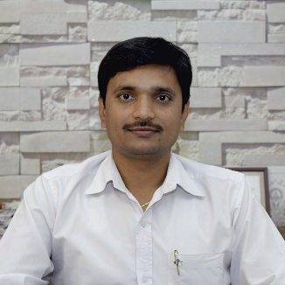
Unit – 5 Multiple integral
Mathematics – I (M-I)
GTU # 3110014
Prof. Kartikraj Dhamsaniya
Humanities & Science Department
kartikraj.dhamsaniya@darshan.ac.in
972 41 42 400

Slide 2
Outline
Looping
D.I. over general region – PC
D.I. by Change of Order of integration
D.I. by Change of Variable of integration – CC & PC
Area by D.I. – CC & PC
Volume by D.I.
T.I. over General Region

Slide 3
METHOD – 6 : D.I. OVER GENERAL REGION IN POLAR COORDINATES(1)
METHOD – 5 : D.I. BY CHANGE OF ORDER OF INTEGRATION(3)
METHOD – 13 : D.I. BY CHANGE OF VARIABLE IN CARTESIAN COORDINATES
METHOD – 14 : D.I. BY CHANGE OF VARIABLE IN POLAR COORDINATES(2)
METHOD – 7 : AREA BY DOUBLE INTEGRATION IN CARTESIAN COORDINATES(1)
METHOD – 8 : AREA BY DOUBLE INTEGRATION IN POLAR COORDINATES
METHOD – 4 : DOUBLE INTEGRALS AS VOLUMES(1)
METHOD – 9 : T.I. OVER GENERAL REGION IN CARTESIAN COORDINATES
METHOD – 10 : T.I. OVER GENERAL REGION IN CYLINDRICAL COORDINATES
METHOD – 11 : T.I. OVER GENERAL REGION IN SPHERICAL COORDINATES(1)

Slide 4
D.I. by change of Variables of integration in CC(Method-13)

Slide 5
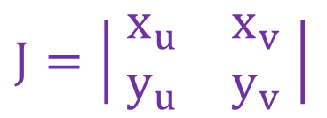
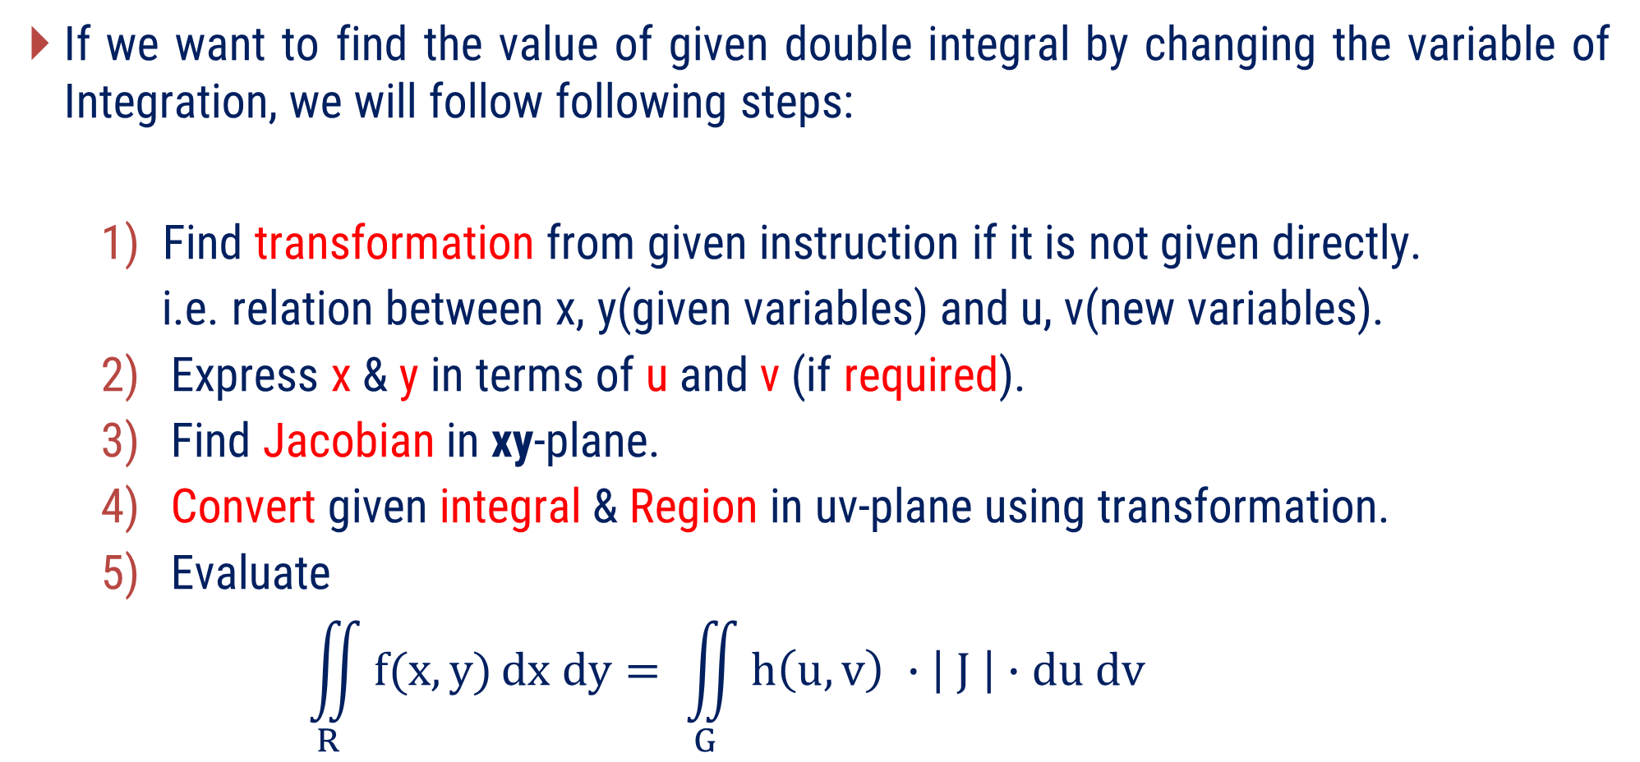
Procedure to find double integral by change of Variable - CC
If we want to find the value of given double integral by changing the variable of Integration, we will follow following steps:
Find transformation from given instruction if it is not given directly.
i.e. relation between x, y(given variables) and u, v(new variables).
Express x & y in terms of u and v (if required).
Find Jacobian in xy-plane.
Convert given integral & Region in uv-plane using transformation.
Evaluate
$$\iint_{R}^{ }{f(x,y)}dx dy= \iint_{G}^{ }{h\left(u,v\right) ∙\left| J \right|}∙du dv$$
$$J=\left| \begin{matrix}x_{u} & x_{v} \\ y_{u} & y_{v}\end{matrix} \right|$$

Slide 6
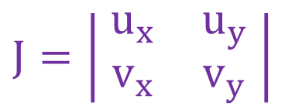
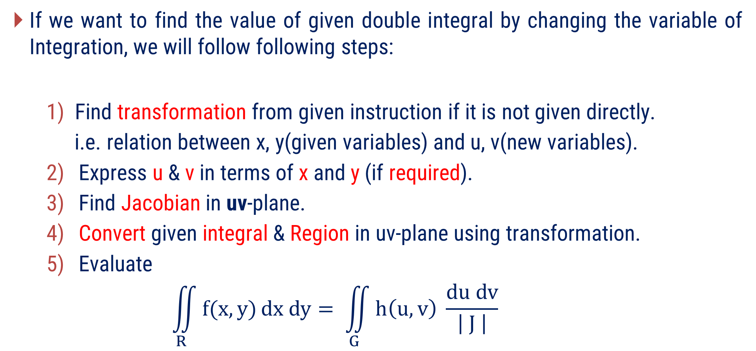
Procedure to find double integral by change of Variable - CC
If we want to find the value of given double integral by changing the variable of Integration, we will follow following steps:
Find transformation from given instruction if it is not given directly.
i.e. relation between x, y(given variables) and u, v(new variables).
Express u & v in terms of x and y (if required).
Find Jacobian in uv-plane.
Convert given integral & Region in uv-plane using transformation.
Evaluate
$$\iint_{R}^{ }{f(x,y)}dx dy= \iint_{G}^{ }{h\left(u,v\right) \frac{du dv}{\left| J \right|}}$$
$$J=\left| \begin{matrix}u_{x} & u_{y} \\ v_{x} & v_{y}\end{matrix} \right|$$

Slide 7
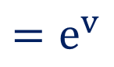



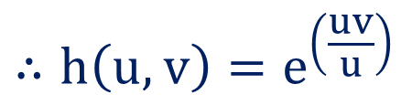






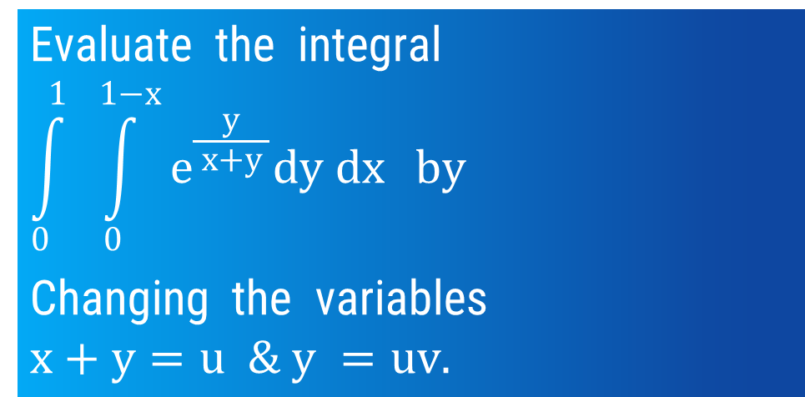
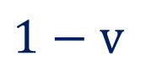

Method 13 $⇒$ Example – 2
Evaluate the integral
$$\int_{0}^{1}{ \int_{0}^{1−x}{e^{\frac{y}{ x+y }}dy dx}} by$$
Changing the variables
$$x+y=u \& y =uv.$$
$$Now J=\left| \begin{matrix}x_{u} & x_{v} \\ y_{u} & y_{v}\end{matrix} \right|$$
Find Transformation
Find Jacobian
Find x & y, in terms of u & v.
Find region & integral in uv-plane.
Solve Double Integral.
$$1−v$$
$$−u$$
$$Now J=\left| \begin{matrix}1−v & −u \\ \begin{aligned} \\ v\end{aligned} & \begin{aligned} \\ u\end{aligned}\end{matrix} \right|$$
$$v$$
$$u$$
$$Now J=u−uv+uv$$
Solution:
$$∴J=u$$
$$We have u=x+y \& y=uv$$
$$Now f\left(x,y\right)=e^{\left(\frac{y}{ x+y }\right)}$$
$∴x=u−uv \& y=uv$
$$∴h\left(u,v\right)=e^{\left(\frac{uv}{ u }\right)}$$
$$=e^{v}$$

Slide 8
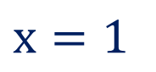

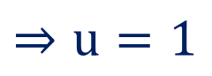
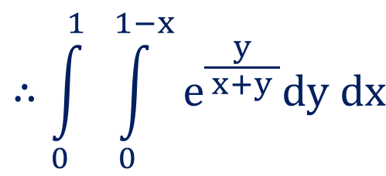
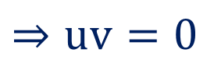


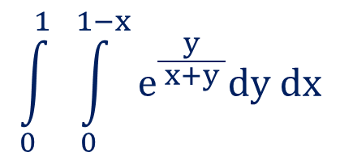


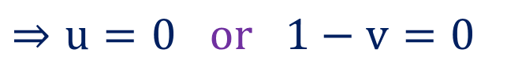
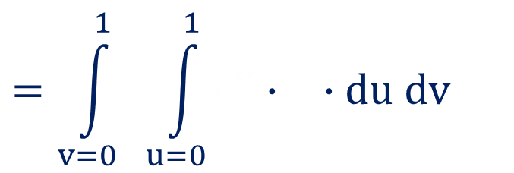
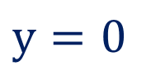

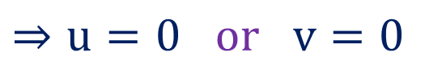
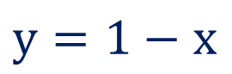



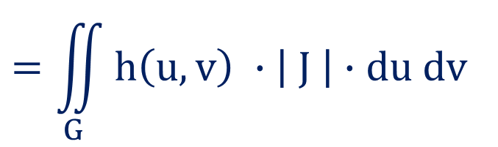
Method 13 $⇒$ Example – 2(continue)
$$From the limits of integration,$$
$$x=1$$
$$\int_{0}^{1}{ \int_{0}^{1−x}{e^{\frac{y}{ x+y }}dy dx}}$$
$$⇒u−uv=1$$
$$y=0$$
$$⇒uv=0$$
$$⇒No conclusion$$
$$⇒u=0 or v=0$$
$$∴\int_{0}^{1}{ \int_{0}^{1−x}{e^{\frac{y}{ x+y }}dy dx}}$$
$$y=1−x$$
$$⇒x+y=1$$
$$⇒u=1$$
$$=\iint_{G}^{ }{h\left(u,v\right) ∙\left| J \right|}∙du dv$$
$$x=0$$
$$⇒u−uv=0$$
$$⇒u=0 or 1−v=0$$
$$=\int_{v=0}^{1}{ \int_{u=0}^{1}{e^{v}∙u∙du dv}}$$
$$e^{v}$$
$$u$$
$$⇒u=0 or v=1$$
……

Slide 9
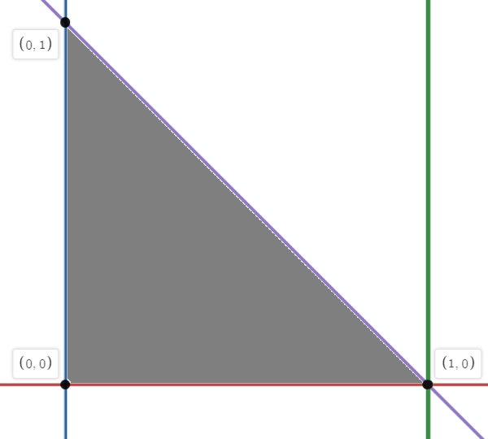

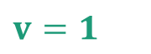
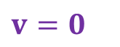
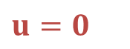
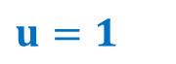
$$v=1$$
$$v=0$$
$$u=0$$
$$u=1$$
From XY plane to UV plane

Slide 10

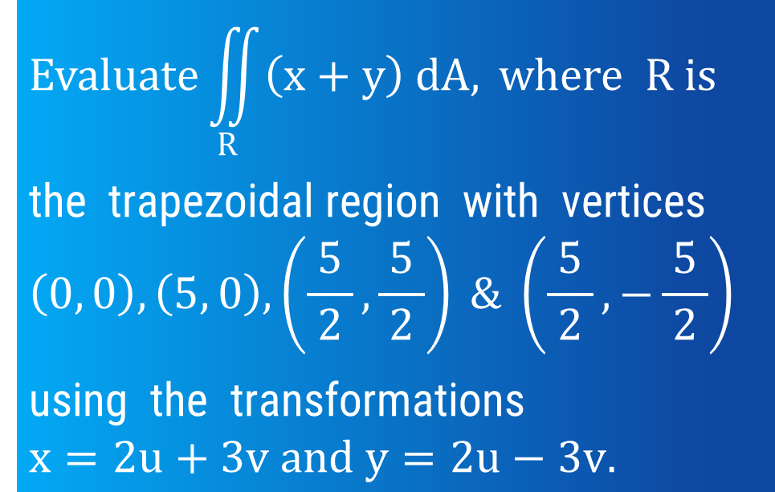




Method 13 $⇒$ Example – 5
$$Evaluate\iint_{R}^{ }{\left(x+y\right) dA,} where R is$$
the trapezoidal region with vertices
$$\left(0, 0\right), \left(5, 0\right), \left(\frac{5}{ 2 }, \frac{5}{ 2 }\right) \& \left(\frac{5}{ 2 }, −\frac{5}{ 2 }\right)$$
using the transformations
$$x=2u+3v and y=2u−3v.$$
$$Now J=\left| \begin{matrix}x_{u} & x_{v} \\ y_{u} & y_{v}\end{matrix} \right|$$
Find Transformation
Find Jacobian
Find x & y, in terms of u & v.
Find region & integral in uv-plane.
Solve Double Integral.
$$Now J=\left| \begin{matrix}2 & 3 \\ \begin{aligned} \\ 2\end{aligned} & \begin{aligned} \\ −3\end{aligned}\end{matrix} \right|$$
$$Now J=−6−6$$
$$∴J=−12$$
$$Now f\left(x,y\right)=x+y$$
Solution:
$$We have x=2u+3v \& y=2u−3v$$
$$∴h\left(u,v\right)=2u+3v+2u−3v$$
$$∴h\left(u,v\right)=4u$$

Slide 11
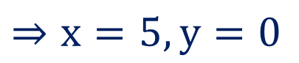
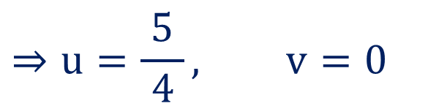
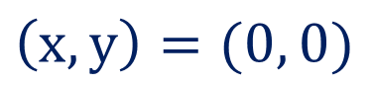
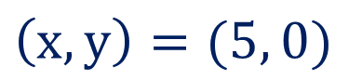
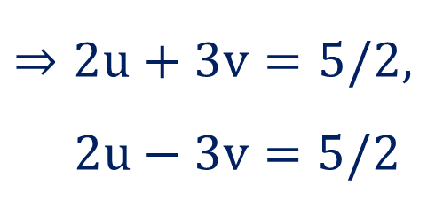
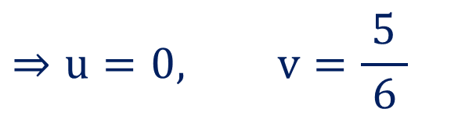
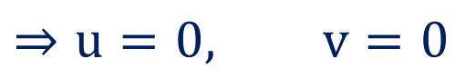
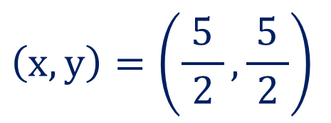
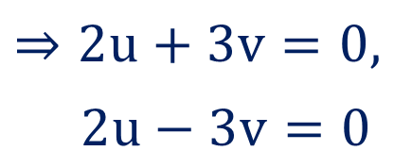
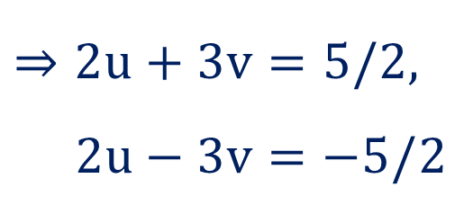
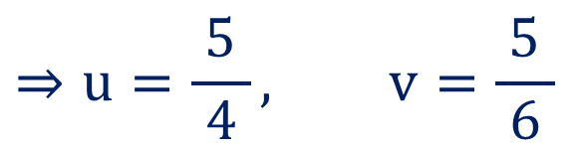
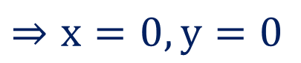
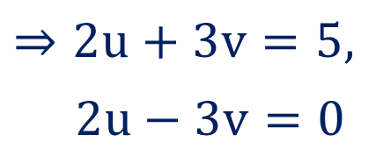
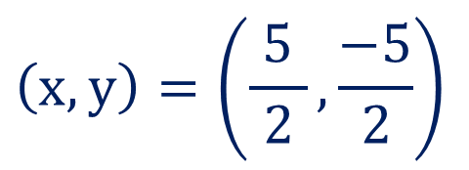
Method 13 $⇒$ Example – 5(continue)
From the Region R,
$$\left(x,y\right)=(0, 0)$$
$$\left(x,y\right)=(5, 0)$$
$$\left(x,y\right)=\left(\frac{5}{ 2 },\frac{5}{ 2 }\right)$$
$$\left(x,y\right)=\left(\frac{5}{ 2 },\frac{−5}{ 2 }\right)$$
$$⇒x=0, y=0$$
$$⇒x=5, y=0$$
$$⇒2u+3v=0,$$
$2u−3v=0$
$$⇒2u+3v=5,$$
$2u−3v=0$
$$⇒2u+3v=5/2,$$
$$2u−3v=5/2$$
$$⇒2u+3v=5/2,$$
$$2u−3v=−5/2$$
$$⇒u=\frac{5}{ 4 }, v=\frac{5}{ 6 }$$
$$⇒u=\frac{5}{ 4 }, v=0$$
$$⇒u=0, v=\frac{5}{ 6 }$$
$$⇒u=0, v=0$$

Slide 12
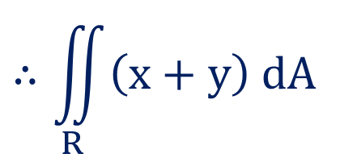
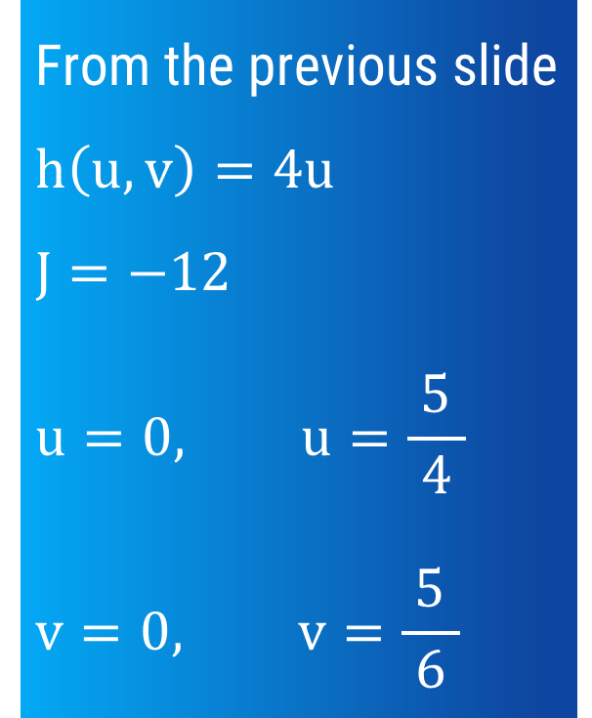
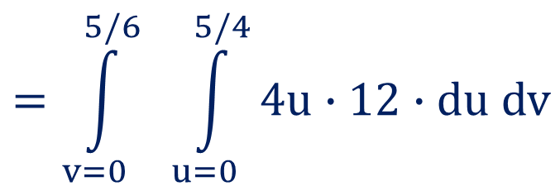
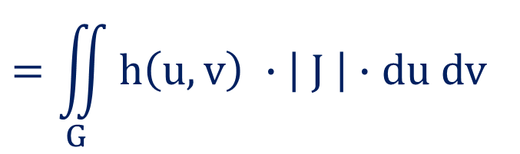
Method 13 $⇒$ Example – 5(continue)
$$∴\iint_{R}^{ }{\left(x+y\right) dA}$$
From the previous slide
$$h\left(u,v\right)=4u$$
$$J=−12$$
$$u=0, u=\frac{5}{ 4 }$$
$$v=0, v=\frac{5}{ 6 }$$
$$=\iint_{G}^{ }{h\left(u,v\right) ∙\left| J \right|}∙du dv$$
$$=\int_{v=0}^{5/6}{ \int_{u=0}^{5/4}{4u∙12∙du dv}}$$
……

Slide 13
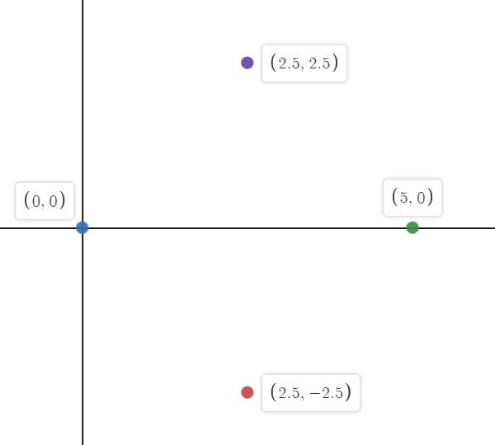
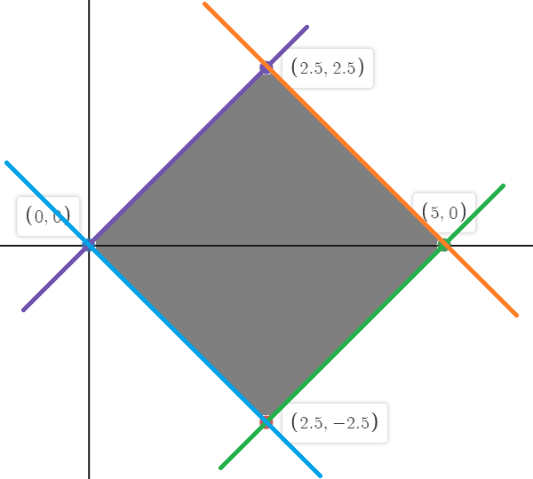
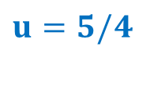

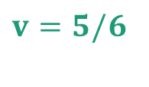
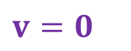
$$v=5/6$$
$$v=0$$
$$u=0$$
$$u=5/4$$
From XY plane to UV plane

Slide 14

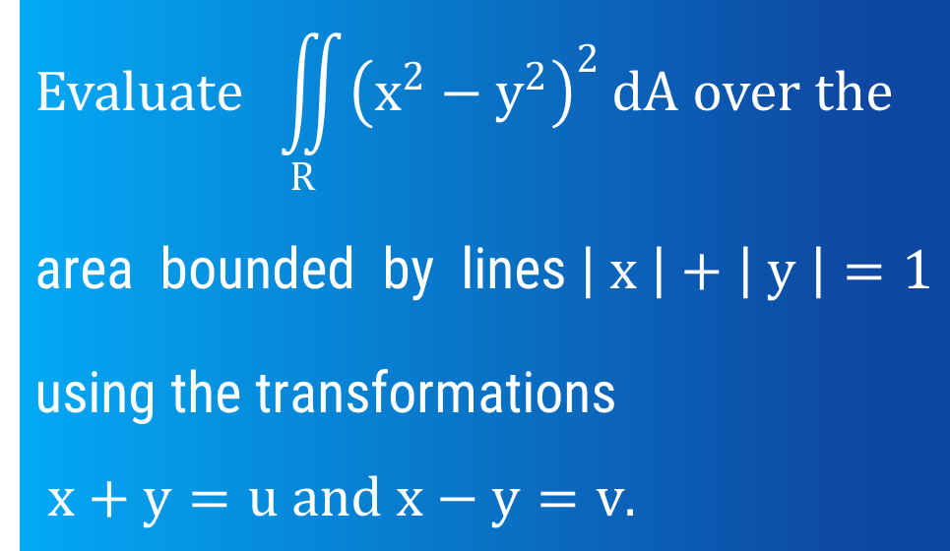





Method 13 $⇒$ Example – 9
$$Evaluate \iint_{R}^{ }{{\left(x^{2}−y^{2}\right)}^{2}}dA over the$$
area bounded by lines$\left| x \right|+\left| y \right|=1$
using the transformations
$$x+y=u and x−y=v.$$
$$Now J=\left| \begin{matrix}u_{x} & u_{y} \\ v_{x} & v_{y}\end{matrix} \right|$$
Find Transformation
Find Jacobian
Find x & y, in terms of u & v.
Find region & integral in uv-plane.
Solve Double Integral.
$$Now J=\left| \begin{matrix}1 & 1 \\ \begin{aligned} \\ 1\end{aligned} & \begin{aligned} \\ −1\end{aligned}\end{matrix} \right|$$
$$Now J=−1−1$$
$$∴J=−2$$
Solution:
$$Now f\left(x,y\right)={\left(x^{2}−y^{2}\right)}^{2}$$
$$We have u=x+y \& v=x−y$$
$$∴f\left(x,y\right)={\left\{ \left(x+y\right) \left(x−y\right) \right\}}^{2}$$
$$∴h\left(u,v\right)=u^{2}v^{2}$$

Slide 15















Method 13 $⇒$ Example – 9(continue)
From the Region R $\text{bounded} \text{by} \text{lines} \left| x \right|+\left| y \right|=1,$
$$∴\iint_{R}^{ }{{\left(x^{2}−y^{2}\right)}^{2}}dA$$
$$x+y=1$$
$$⇒u=1$$
$$x−y=1$$
$$⇒v=1$$
$$=\iint_{G}^{ }{h\left(u,v\right) }\frac{ du dv }{\left| J \right|}$$
$$−x+y=1$$
$$⇒x−y=−1$$
$$⇒v=−1$$
$$−x−y=1$$
$$⇒x+y=−1$$
$$⇒u=−1$$
$$=\int_{v=−1}^{1}{ \int_{u=−1}^{1}{u^{2}v^{2} }\frac{ du dv }{2}}$$
$$u^{2}v^{2}$$
$$2$$
……

Slide 16






$$v=1$$
$$u=−1$$
$$u=1$$
$$v=−1$$
From XY plane to UV plane

Slide 17



Method 13 $⇒$ Example – 3
$$Evaluate\iint_{R}^{ }{\left(x^{2}+y^{2}\right)dA}, by changing the variables, where R is the region$$
$$lying in the first quadrant and bounded by the hyperbolas$$
$$x^{2}−y^{2}=9, x^{2}−y^{2}=1, xy=2 and xy=4.$$
Solution:
$$\text{Here} \text{transformation} \text{is} \text{not} \text{given} \text{directly}\text{.}$$
$$\text{So} \text{from} \text{the} \text{instruction} \text{we} \text{will} \text{take}$$
$${u=x}^{2}−y^{2} and v=xy.$$

Slide 18

















Method 13 $⇒$ Example – 3(continue)
$${u=x}^{2}−y^{2} and v=xy.$$
$$Now J=\left| \begin{matrix}u_{x} & u_{y} \\ v_{x} & v_{y}\end{matrix} \right|$$
From the Region R,
$$∴\iint_{R}^{ }{\left( x^{2}+y^{2} \right)}dA$$
$$x^{2}−y^{2}=9$$
$$⇒u=9$$
$$Now J=\left| \begin{matrix}2x & −2y \\ \begin{aligned} \\ y\end{aligned} & \begin{aligned} \\ x\end{aligned}\end{matrix} \right|$$
$$x^{2}−y^{2}=1$$
$$⇒u=1$$
$$=\iint_{G}^{ }{h\left(u,v\right) }\frac{ du dv }{\left| J \right|}$$
$$Now J=2x^{2}+2y^{2}$$
$$xy=2$$
$$⇒v=2$$
$$=\int_{v=2}^{4}{ \int_{u=1}^{9}{\frac{1}{ 2 }} du dv}$$
$$∴J=2(x^{2}+y^{2})$$
$$xy=4$$
$$⇒v=4$$
$$Now f\left(x,y\right)=x^{2}+y^{2}$$
……

Slide 19










$$v=9$$
$$v=2$$
$$u=1$$
$$u=9$$
From XY plane to UV plane

Slide 20
D.I. by change of Variables of integration in PC(Method-14)

Slide 21

Procedure to find double integral by change of Variable - PC
If we want to find the value of given double integral by changing the variable of Integration, we will follow following steps:
Use transformation x = r cos θ and y = r sin θ.
i.e. relation between x, y(given variables) and r, θ(new variables).
Draw the region in xy-plane.
Convert given integral & Region in rθ-plane using transformation.
Evaluate
$$\iint_{R}^{ }{f(x,y)}dx dy= \iint_{G}^{ }{h\left(r,\text{θ}\right)∙r∙dr d\text{θ}}$$

Slide 22








Method 14 $⇒$ Example – 1
$$By changing into polar coordinates,$$
$$evaluate \int_{0}^{1}{ \int_{0}^{1}{dx dy}}.$$
Use Transformation
Draw the region
Find region & integral in rθ-plane.
Solve Double Integral.
$$y=1$$
Solution:
Let us take x = r cos θ and y = r sin θ.
Form the limits of integral we have,
$$x=0, x=1 \&$$
$$y=0, y=1.$$
$$y=0$$
$$x=0$$
$$x=1$$

Slide 23


















Method 14 $⇒$ Example – 1(continue)
From the Region R,
$$x=0$$
$$⇒r cos θ=0$$
$$⇒r=0 or cos θ=0$$
$$⇒r=0 or θ=π/2$$
$$x=1$$
$$⇒r cos θ=1$$
$$⇒r=1/cos θ$$
$$⇒r=\sec{θ}$$
$$y=0$$
$$⇒r sin θ=0$$
$$⇒r=0 or sin θ=0$$
$$⇒r=0 or θ=0$$
$$y=1$$
$$⇒r sin θ=1$$
$$⇒r=1/sin θ$$
$$⇒r=\operatorname{cosec}{θ}$$
And $f\left(x,y\right)=1$
$$⇒f\left(r, θ\right)=1$$

Slide 24







Method 14 $⇒$ Example – 1(continue)
$$\int_{0}^{1}{ \int_{0}^{1}{dx dy}}=\iint_{G}^{ }{h\left(r,\text{θ}\right)∙r∙dr d\text{θ}}$$
$$y=1$$
$$r=cosec θ$$
$$=\iint_{G_{1}}^{ }{r dr d\text{θ}}+\iint_{G_{2}}^{ }{r dr d\text{θ}}$$
$$r=sec θ$$
$$=\int_{0}^{π/4}{ \int_{0}^{sec θ}{r dr d\text{θ}}}+$$
$$+\int_{π/4}^{π/2}{ \int_{0}^{cosec θ}{r dr d\text{θ}}}$$
$$y=0$$
……
$$x=0$$
$$x=1$$

Slide 25






Method 14 $⇒$ Example – 3
$$Evaluate the integral$$
$$\int_{0}^{∞}{ \int_{0}^{∞}{\frac{1}{{ \left(1+x^{2}+y^{2}\right)}^{2} }dx dy.}}$$
Use Transformation
Draw the region
Find region & integral in rθ-plane.
Solve Double Integral.
$$y=∞$$
Solution: S-19(3marks)
Let us take x = r cos θ and y = r sin θ.
Form the limits of integral we have,
$$x=0, x=∞ \&$$
$$y=0, y=∞.$$
$$y=0$$
$$x=0$$
$$x=∞$$

Slide 26








Method 14 $⇒$ Example – 3(continue)
From the Region R,
$$x=0$$
$$⇒r cos θ=0$$
$$⇒r=0 or cos θ=0$$
$$⇒r=0 or θ=π/2$$
$$x=∞$$
$$⇒r cos θ=∞$$
$$⇒r=∞$$
$$y=0$$
$$⇒r sin θ=0$$
$$⇒r=0 or sin θ=0$$
$$⇒r=0 or θ=0$$
$$y=∞$$
$$⇒r sin θ=∞$$
$$⇒r=∞$$
$$And f\left(x,y\right)=\frac{1}{{ \left(1+x^{2}+y^{2}\right)}^{2} }$$
$$⇒f\left(r, θ\right)=\frac{1}{{ \left(1+r^{2}\right)}^{2} }$$

Slide 27



Method 14 $⇒$ Example – 3(continue)
$$r=∞$$
$$\int_{0}^{1}{ \int_{0}^{1}{dx dy}}=\iint_{G}^{ }{h\left(r,\text{θ}\right)∙r∙dr d\text{θ}}$$
$$y=∞$$
$$=\int_{0}^{π/2}{ \int_{0}^{∞}{\frac{1}{{ \left(1+r^{2}\right)}^{2} } r dr d\text{θ}}}$$
$$r=∞$$
……
$$y=0$$
$$x=0$$
$$x=∞$$

Slide 28









Method 14 $⇒$ Example – 7
By changing into polar co$−$ordinates, evaluate the integral
$$\int_{0}^{2a}{ \int_{0}^{\sqrt{2ax−x^{2} }}{\left(x^{2}+y^{2}\right) dy dx.}}$$
Use Transformation
Draw the region
Find region & integral in rθ-plane.
Solve Double Integral.
$$x=0$$
$$x=2a$$
$$y=\sqrt{2ax−x^{2} }$$
Solution:
Let us take x = r cos θ and y = r sin θ.
$$y=0$$
Form the limits of integral we have,
$$y=0, y=\sqrt{2ax−x^{2} } \&$$
$$x=0, x=2a.$$

Slide 29
















Method 14 $⇒$ Example – 7(continue)
From the Region R,
$$y=0$$
$$⇒r sin θ=0$$
$$⇒r=0 or sin θ=0$$
$$⇒r=0 or θ=0$$
$$x=0$$
$$⇒r cos θ=0$$
$$⇒r=0 or cos θ=0$$
$$⇒r=0 or θ=π/2$$
$$x=2a$$
$$⇒r cos θ=2a$$
$$⇒r=2a\sec{θ}$$
$$y =\sqrt{2ax−x^{2} }$$
$$y^{2} =2ax−x^{2}$$
$$r^{2}\sin^{2}{ θ} =2a r cos θ−r^{2}\cos^{2}{θ}$$
$$r^{2} =2a r cos θ$$
$$y=\sqrt{2ax−x^{2} }$$
$$⇒r=2a\cos{θ}$$
And $f\left(x,y\right)=x^{2}+y^{2}$
$$⇒f\left(r, θ\right)=r^{2}$$

Slide 30





Method 14 $⇒$ Example – 7(continue)
$$\int_{0}^{2a}{ \int_{0}^{\sqrt{2ax−x^{2} }}{\left(x^{2}+y^{2}\right) dy dx}}$$
$$=\iint_{G}^{ }{h\left(r,\text{θ}\right)∙r∙dr d\text{θ}}$$
$$x=0$$
$$y=\sqrt{2ax−x^{2} }$$
$$x=2a$$
$$r=2a\cos{θ}$$
$$=\int_{0}^{π/2}{ \int_{0}^{2a\cos{θ}}{r^{2}∙r∙dr d\text{θ}}}$$
$$y=0$$
……

Slide 31
















For Reference:
$$\int_{0}^{\frac{ π }{2}}{\sin^{n}{x}} dx=I_{n}$$
$$\int_{0}^{\frac{ π }{2}}{\cos^{n}{x}} dx=I_{n}$$
$$⇒I_{n}=\frac{n−1 }{n} I_{n−2}$$
$$;where I_{0}=\frac{ π }{2}, I_{1}=1$$
$$\int_{0}^{\frac{ π }{2}}{\sin^{6}{x}} dx=I_{6}$$
$$\int_{0}^{\frac{ π }{2}}{\cos^{7}{x}} dx=I_{7}$$
$$⇒I_{6}=\frac{ 5 }{6} I_{4}$$
$$⇒I_{7}=\frac{ 6 }{7} I_{5}$$
$$=\frac{ 5 }{6}\frac{3}{ 4 }I_{2}$$
$$=\frac{ 6 }{7} \frac{4}{ 5 }I_{3}$$
$$=\frac{ 15 }{24}{\frac{1}{ 2 }I}_{0}$$
$$=\frac{ 24 }{35}{ \frac{2}{ 3 }I}_{1}$$
$$=\frac{ 15 }{48}\frac{ π }{2}$$
$$=\frac{ 48 }{ 105 } 1$$
$$⇒I_{6}=\frac{ 5 }{6} \frac{ 3 }{4} \frac{ 1 }{2} \frac{ π }{2}$$
$$⇒I_{6}=\frac{ 6 }{7} \frac{ 4 }{5} \frac{ 2 }{3} 1$$

Slide 32






Method 14 $⇒$ Example – 9
$$Integrate f\left(x , y\right)=\frac{\ln{ {(x}^{2}+y^{2})} }{\sqrt{x^{2}+y^{2} }} over$$
the region 1 $≤ x^{2}+y^{2}≤$ e by
changing into polar coordinates.
Use Transformation
Draw the region
Find region & integral in rθ-plane.
Solve Double Integral.
$$x^{2}+y^{2}≤ \text{e}$$
Solution:
$$\text{1 }≤ x^{2}+y^{2}$$
Let us take x = r cos θ and y = r sin θ.
Form the region we have,
1 $≤ x^{2}+y^{2}$ & $x^{2}+y^{2}≤$ e

Slide 33






Method 14 $⇒$ Example – 9(continue)
From the Region R,
$$x^{2}+y^{2}=1$$
$$⇒r=1$$
$$x^{2}+y^{2}=e$$
$$⇒r=\sqrt{e }$$
$$And f\left(x,y\right)=\frac{\ln{ {(x}^{2}+y^{2})} }{\sqrt{x^{2}+y^{2} }}$$
$$⇒f\left(r, θ\right)=\frac{ \ln\left(r^{2}\right) }{r}$$

Slide 34



Method 14 $⇒$ Example – 9(continue)
$$\iint_{R}^{ }{\left(\frac{\ln{ {(x}^{2}+y^{2})} }{\sqrt{x^{2}+y^{2} }}\right) dA}$$
$$=\iint_{G}^{ }{h\left(r,\text{θ}\right)∙r∙dr d\text{θ}}$$
$$x^{2}+y^{2}≤ \text{e}$$
$$=\int_{0}^{2π}{ \int_{1}^{\sqrt{e }}{\frac{ \ln\left(r^{2}\right) }{r}∙r∙dr d\text{θ}}}$$
$$\text{1 }≤ x^{2}+y^{2}$$
……

Slide 35
METHOD – 6 : D.I. OVER GENERAL REGION IN POLAR COORDINATES(1)
METHOD – 5 : D.I. BY CHANGE OF ORDER OF INTEGRATION(3)
METHOD – 13 : D.I. BY CHANGE OF VARIABLE IN CARTESIAN COORDINATES
METHOD – 14 : D.I. BY CHANGE OF VARIABLE IN POLAR COORDINATES(2)
METHOD – 7 : AREA BY DOUBLE INTEGRATION IN CARTESIAN COORDINATES(1)
METHOD – 8 : AREA BY DOUBLE INTEGRATION IN POLAR COORDINATES
METHOD – 4 : DOUBLE INTEGRALS AS VOLUMES(1)
METHOD – 9 : T.I. OVER GENERAL REGION IN CARTESIAN COORDINATES
METHOD – 10 : T.I. OVER GENERAL REGION IN CYLINDRICAL COORDINATES
METHOD – 11 : T.I. OVER GENERAL REGION IN SPHERICAL COORDINATES(1)

Slide 36
Area by Double integration in CC(Method-7)

Slide 37

Area by Double integration in CC(Method-7)
The area of a closed, bounded plane region R is
$$Area=\iint_{R}^{ }{dA}$$
$$Area=\iint_{R}^{ }{dx dy}$$
$$Area=\iint_{R}^{ }{dy dx}$$

Slide 38












Method 7 $⇒$ Example – 2
Find the area of the region bounded by the curves $y=\sin{x, y=\cos{x}}$ and the lines $x=0 and x=π/4$.
$$y=\cos{x}$$
$$y=\sin{x}$$
Solution: S-19 (4 marks)
We have
$y=\sin{x, y=\cos{x}}$ &
$$x=0 and x=\frac{ π }{4}$$
$$x=0$$
$$x=π/4$$
$$\int_{0}^{\frac{π}{4}}{ \int_{\sin{x}}^{\cos{x}}{ dy dx}}$$
$$∴Area=\iint_{R}^{ }{dA}=$$
……

Slide 39








Method 7 $⇒$ Example – 3
Using the double integration, find the area of the region common to the parabolas $y^{2}=8x and x^{2}=8y$.
$$x^{2}=8y$$
Solution:
We have
$y^{2}=8x$and$x^{2}=8y$
$$\int_{0}^{8}{ \int_{y^{2}/8}^{\sqrt{8y }}{ dx dy}}$$
$$∴Area=\iint_{R}^{ }{dA}=$$
$$y^{2}=8x$$
……

Slide 40








Method 7 $⇒$ Example – 5
Find the area of region included between the curve$y^{2}\left(2a−x\right)=x^{3}$ and its asymptote.
$$y^{2}\left(2a−x\right)=x^{3}$$
$$x=2a$$
Solution:
We have$y^{2}\left(2a−x\right)=x^{3}$ & $x=2a$
$$\int_{0}^{2a}{ \int_{−\sqrt{\frac{x^{3}}{ 2a−x } }}^{+\sqrt{\frac{x^{3}}{ 2a−x } }}{ dy dx}}$$
$$∴Area=\iint_{R}^{ }{dA}=$$
……

Slide 41

Method 7 $⇒$ Example – 5(continue)

Slide 42

Method 7 $⇒$ Example – 5(continue)

Slide 43
Area by Double integration in PC(Method-8)

Slide 44

Area by Double integration in PC(Method-8)
The area of a closed, bounded plane region R is
$$Area=\iint_{R}^{ }{dA}$$
$$Area=\iint_{R}^{ }{r dr dθ}$$

Slide 45










Method 8 $⇒$ Example – 2
Find the area common to both of the circles $r=\cos{θ}$ and $r=\sin{θ}.$
$$r=\sin{θ}$$
Solution:
We have $r=\cos{θ} \text{and} r=\sin{θ}$
$$∴Area=\iint_{R}^{ }{dA}=$$
$$\int_{0}^{π/4}{ \int_{0}^{\sin{θ}}{r dr dθ}}$$
$$+\int_{π/4}^{π/2}{ \int_{0}^{\cos{θ}}{r dr dθ}}$$
……
$$r=\cos{θ}$$

Slide 46









Method 8 $⇒$ Example – 4
Find the area of the region that lies inside the cardioid $r=1+cos θ$ and outside the circle $r=1$ by double integration.
$$r=1$$
$$r=1+cos θ$$
Solution:
We have $r=1+cos θ \text{and} r=1$
$$∴Area=\iint_{R}^{ }{dA}=$$
$$\int_{−π/2}^{π/2}{ \int_{1}^{1+cos θ}{r dr dθ}}$$
……

Slide 47









Method 8 $⇒$ Example – 7
Find the total area enclosed by lemniscate $r^{2}=a^{2}\cos{2θ}.$
$$r^{2}=a^{2}\cos{2θ}$$
Solution:
We have $r^{2}=a^{2}\cos{2θ}$
$$2\int_{−π/4}^{π/4}{ \int_{0}^{\sqrt{a^{2}\cos{2θ} }}{r dr dθ}}$$
$$4\int_{0}^{π/4}{ \int_{0}^{\sqrt{a^{2}\cos{2θ} }}{r dr dθ}}$$
$$∴Area=\iint_{R}^{ }{dA}=$$
……
……

Slide 48


